Slide 1
Nurse Licensure Compact
Rhode Island House of Representatives Special Commission
April 18, 2023

Slide 2
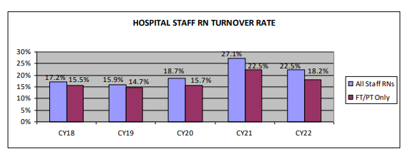
National Turnover
2023 NSI Nursing Solutions, Inc. Survey of hospitals across the U.S.
          Nationally, Hospital Turnover stands at 22.7%.
          RN turnover stands at 22.5%.
            Lowest – Surgical Services (16.0%), Women's Care (17.2%), and Pediatrics (17.1%).
            Highest – Med/Surg (23.1%), Step down (23.7%), and Telemetry (27.1%).
*2023 NSI National Health Care Retention & RN Staffing Report
Notes:
>3000 hospitals across the U.S. invited to participate; 273 did. In total, this survey covers 736,021 healthcare workers, and 202,502 Registered Nurses.
Covers January through December 2022.
Its the nation’s most comprehensive survey on healthcare turnover, retention initiatives, vacancy rates, recruitment metrics and staffing strategies.

Slide 3
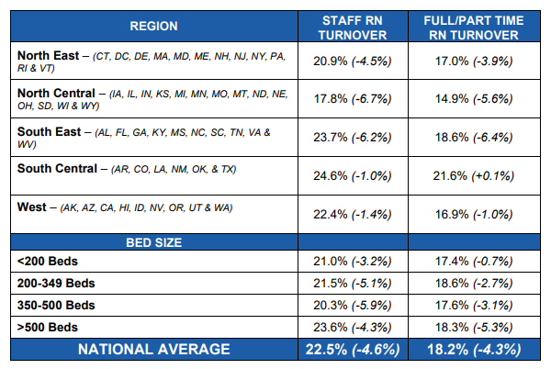
National Nursing Turnover by Region
Greatest retention capacity is a hospital with less than 200 beds in the North-Central Region.
Conversely, a hospital with the highest turnover is a facility in the South-East or West with between 200 to 349 beds.
*2023 NSI National Health Care Retention & RN Staffing Report

Slide 4
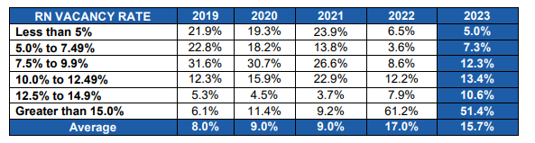
National Nursing Vacancy Rate
*2023 NSI National Health Care Retention & RN Staffing Report
Average RN Vacancy Rate 15.7%.
75.4% of hospitals reported a vacancy rate > 10%
The average time to recruit an experienced RN ranged from 61 to 120 days.
Average time to fill a vacancy, regardless of specialty, is 95 days (8 day increase from 2021).
Notes:
Lured by lucrative travel assignments or feelings of disillusionment, exhaustion or burnout, RNs marched from the bedside at an alarming rate. While RN travel pay remains high and varies by geography and specialty, nationally it has decreased 20.4%, thus helping Talent Acquisition add RNs back to payroll.

Slide 5
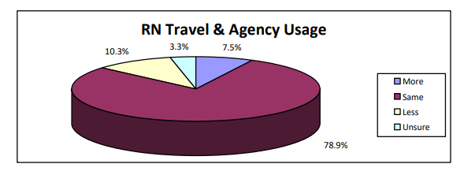
National Travel & Agency Use
*2023 NSI National Health Care Retention & RN Staffing Report
Hospitals were asked to project travel use over the next 12 months.
Approximately eighty percent (78.9%) of hospitals anticipate using the same number of supplemental staff in 2023.
While RN travel pay remains high and varies by geography and specialty, nationally it has decreased 20.4%.
Converting 20 agency RNs to staff can save hospitals just over $3M.

Slide 6
Care New England Health System
Butler
Butler Hospital is the premier treatment, teaching and research hospital for psychiatric, movement and memory disorders, serving Rhode Island and southeastern Massachusetts. Butler offers acute inpatient and partial hospital services for psychiatric and substance abuse treatment for adults and adolescents and includes a state-of-the-art senior treatment center.
Kent
Kent Hospital, the second-largest hospital in Rhode Island, provides a full spectrum of primary and acute care services. Kent Hospital is an affiliate of the University of New England College of Osteopathic Medicine (UNECOM) for medical education.
Woman & Infants
Women & Infants Hospital is the region’s premier hospital for women and newborn children. It is the nation’s eighth busiest stand-alone obstetrical service and operates one of the nation’s largest single-family room neonatal intensive care units.

Slide 7
Care New England Health System
Care New England currently employ’s 1483 nurses.
  Butler Hospital - 282
  Kent Hospital - 496
  Women & Infants - 654
  Remainder spread out across Care New England Medical Group, The Providence Center and VNA of CNE.

Slide 8
CNE Nursing Turnover & Vacancy
Butler
RN Turnover %
  2021 - 10.4%
  2022 - 14.5%
Vacancy Rate
  Current - 14%
    Float Pool
Woman & Infants
RN Turnover %
  2021 - 6.2%
  2022 - 10.5%
Vacancy Rate
  Current - 3.8%
Kent
RN Turnover %
  2021 - 27.9%
  2022 - 26.4%
Vacancy Rate
  Current - 18.5%
    ED
    Float Pool

Slide 9
CNE Travel & Agency Use
CNE Affiliate | 2020 | 2021 | 2022 | 2023
Field Hospital | 23 | 52 | - | -
Kent Hospital | 41 | 175 | 127 | 32
VNA of CNE | - | - | 2 | 1
W&I Hospital | 1 | 24 | 34 | 17
Total | 65 | 251 | 163 | 50

Slide 10
Addressing Quality Through Competency
Medication Administration Test
Cardiac Dysrhythmia Test
IV Course and then IV Test
Proper Donning & Doffing of PPE Competency

Slide 11
Addressing Quality Through Competency
Inpatient Nurse Residency Program
New Graduates, <1 year experience
Emergency Department (ED) Nurse Residency Program
New Graduates, < 2 years ED experience
Essentials of Critical Care (ECCO) Program
New Graduates, <2 years Critical Care experience

Slide 12
Benefits of NCL Participation
Improved ability to recruit RNs to the Northeast
Decreases average days to fill vacant positions
Telehealth Opportunities
Disaster Response

